Slide 1

Alternating group lasso for block-term tensor decomposition with application to ECG source separation
J. H. de M. Goulart et al., 2020
Lucas Abdalah
TIP8419 - Álgebra Linear e Multilinear
07-07-2022
Notes:
Apresentação (Nome, Curso)
Abordagem de Decomposição em Termos de Blocos (TENSORIAL)
Problemas de Separação Cega de Fontes (BSS)
Telecomunicações diversos
Sinais biomédicos: ECG, BSPM (Body Surface Potential Mapping) , EEG.
A estrutura impõe desafio na estimação de parâmetros do número de blocos e de posto.
Modelos clássicos Non-Linear Least Squares (NLS)
Este artigo propõe um algoritmo AGL para estimar simultaneamente a decomposição e seus parâmetros.
Versão com uma premissa/imposição chamada CAGL assumindo um comportamento característico da fonte.
Problema BSS em Eletrocardiogramas (ECG)
Impõe limitações do conhecimento do comportamento fisiológico (Ground-Truth)

Slide 2
I. Introduction

Slide 3
I. Introduction
Biomedical Application: Atrial activity extraction during a persistent Atrial Fibrillation (AF).
Blind Source Separation (BSS)
Matrix Approach
Principal component analysis (PCA)
Independent component analysis (ICA)
Tensor Approach
BTD-Gauss Newton (ALS-NLS or ELS)
AGL and its Constrained Version, CAGL
Notes:
1. Atrial Activity during AF
2. Strong mathematical constraints are necessary to assure uniqueness of the decomposition,
such as mutual orthogonality between spatial factors and statistical independence.
The best-known methods are based on principal and independent component analysis.
3. Uniqueness ensured under milder constraints.
Outperforms matrix-based methods
A celebrated method is the block term decomposition (BTD)

Slide 4

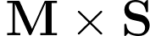
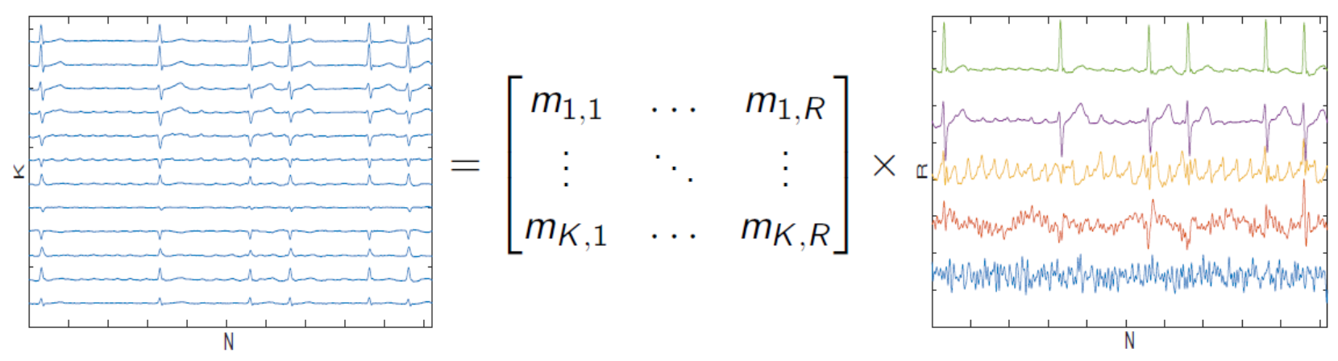
Matrix Approach
Figure : Classic model for BSS.

Slide 5
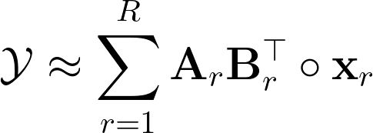
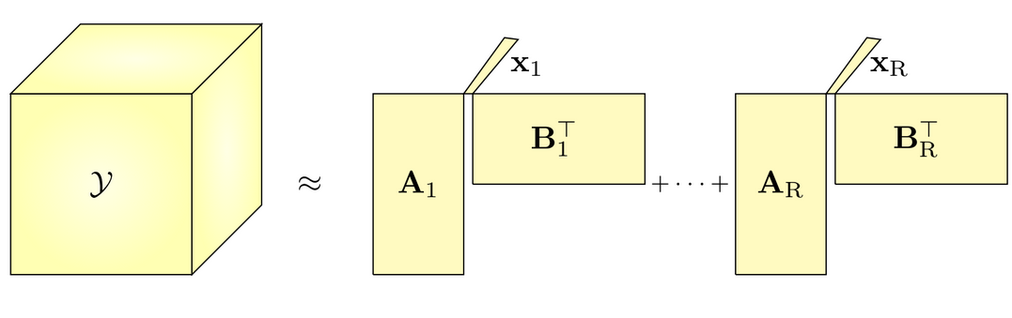
Tensor Approach
Figure : BTD model for BSS.

Slide 6
II. Tensor-Based Separation of Sums of Complex Exponentials
Notes:
A. Low-rank Hankel source model
B. Separation of linear mixture via BTD
C. Approximate BTD
D. Shortcomings of the standard least-squares approach
E. Structured low-rank approximation

Slide 7
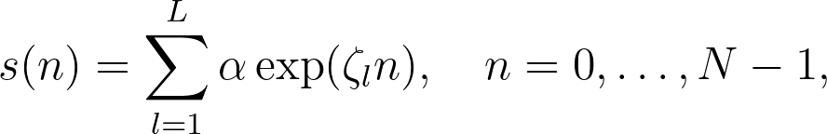
A. Low-rank Hankel source model
Discrete-time signals that can be modeled as linear combination of exponentials
The signal s(n) is represented by an all-pole model
Mapped onto a Hankel matrix Hs
Hankel matrix has rank at most min{L,M}¹
¹D. L. Boley, et. al (1997): “Vandermonde factorization of a Hankel matrix,” in Proc. Workshop Scientific Comput.

Slide 8
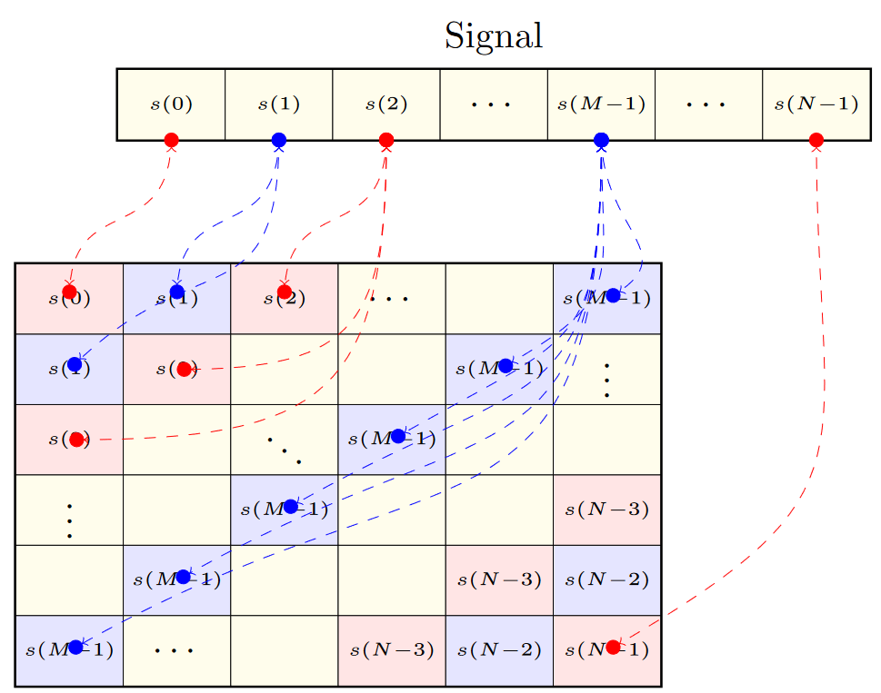
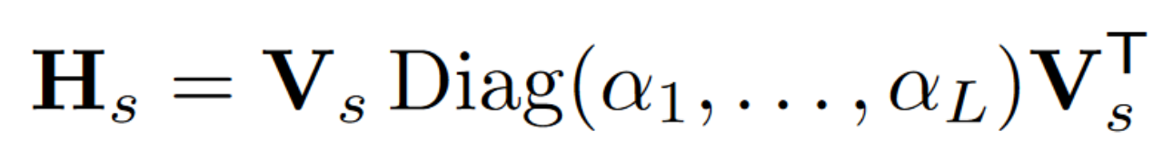
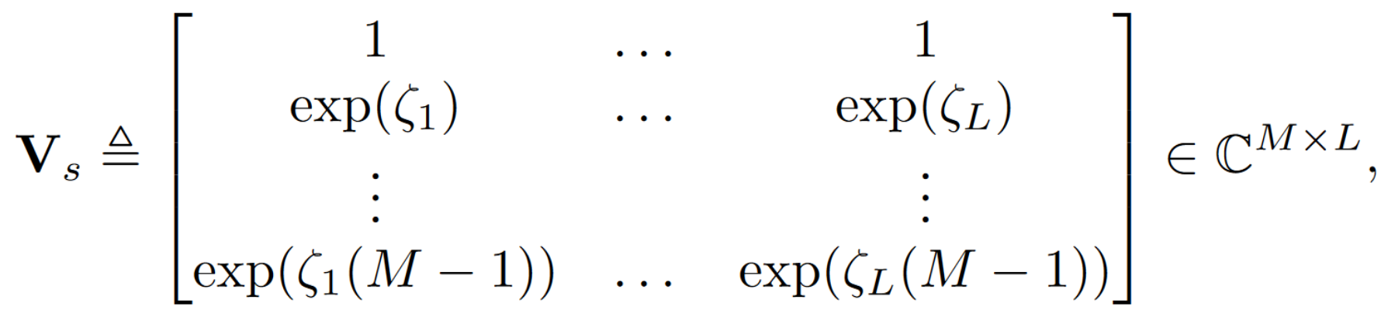
A. Low-rank Hankel source model
Hankel Matrix and Vandermonde Decomposition:
Since the sources can be expressed as low-rank Hankel matrices, the signal separation can be performed via BTD.
Figure : Hankel mapping.

Slide 9
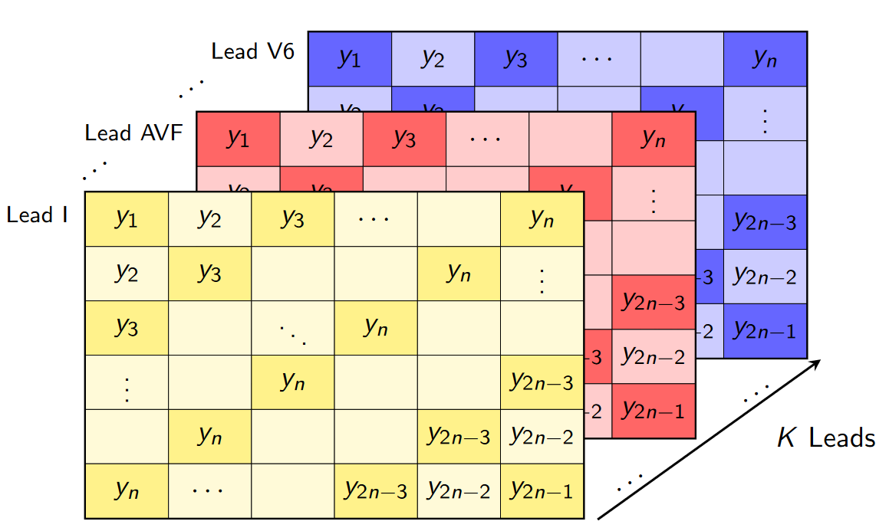
B. Separation of linear mixture via BTD
Spatial diversity plays an essential role on source estimation
Each observed signal (Y) is mapped onto a structured Hankel Matrix
Where we stack each these matrices in the 3rd-mode of the tensor data (M x M x K)
Figure : Tensor built of data Hankel matrices.

Slide 10
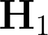
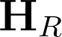
B. Separation of linear mixture via BTD
Source estimation and its associated Hankel matrix
Each Hankel Matrix has rank Lr
The data tensor 𝒚 consists of a sum of R blocks
Each block is given by the tensor (outer) product of a low-rank Hankel matrix and a vector
Figure : Structured-BTD model for BSS.

Slide 11
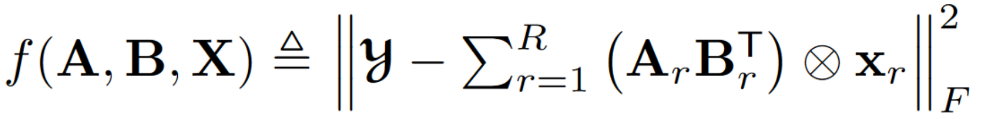
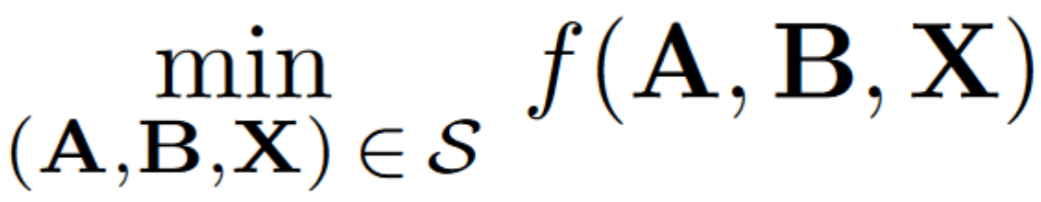
C. Approximate BTD
Existence and Uniqueness
Fixed structure
Prior Knowledge of (R, Lr)
Complex values and require additional constraints (as a structured matrix)
Notes:
1. Pode não obter um mínimo global, dado que podemos obter diversos conjuntos de decomposições, dado que a solução não é necessariamente fechada. (Como há exemplos demonstrados na literatura [10]. Porém, para tensores de valor complexo, [20] mostra que esse problema afeta apenas tensores de conjuntos de volume zero e, portanto, é de menor relevância na prática.
2.

Slide 12
D. Shortcomings of the standard least-squares approach
Blocks and rank remarks
Flexibility regarding the ranks Lr of the blocks (which can be very different from one another)
Rank Inversion and overestimation
Set of possible ranks is restricted (it becomes more severe as the number of blocks grows)
Figure : BTD model for BSS.
Notes:
This occurs, for instance, in the application considered in this paper, where accurate approximation of a ventricular signal typically needs more poles, and therefore higher rank, than an atrial signal
3. The same does not happen at a higher level of noise. This probably happens because the local optimization algorithms used to solve the nonconvex problem
4.

Slide 13
III. Alternating Group Lasso Algorithm for BTD
Notes:
A. Problem formulation
B. Algorithm for unconstrained blocks
C. Handling linear constraints in Hr

Slide 14
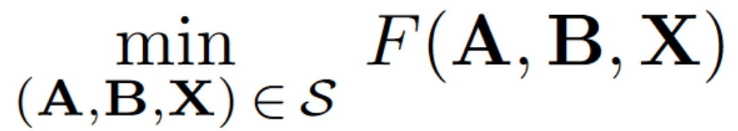
A. Problem formulation
Constrained Alternating Group Lasso (CAGL) Approach
Non-fixed structure minimizing F(A, B, X) ensuring the Hankel structure
Penalization term (𝛾) and g(A, B, X) limiting the multilinear ranks and number of blocks
Allows simultaneous estimation of (R, Lr) and model factors
Notes:
1. Hence, for sufficiently high γ, minimizers of (9) will be formed by A and B displaying some columns made entirely of zeros, effectively yielding a BTD of low-rank blocks. The same applies to X, possibly reducing the number of blocks. This allows much more flexibility compared to (7), since now the number of degrees of freedom of the model can adapt to the data Y.

Slide 15
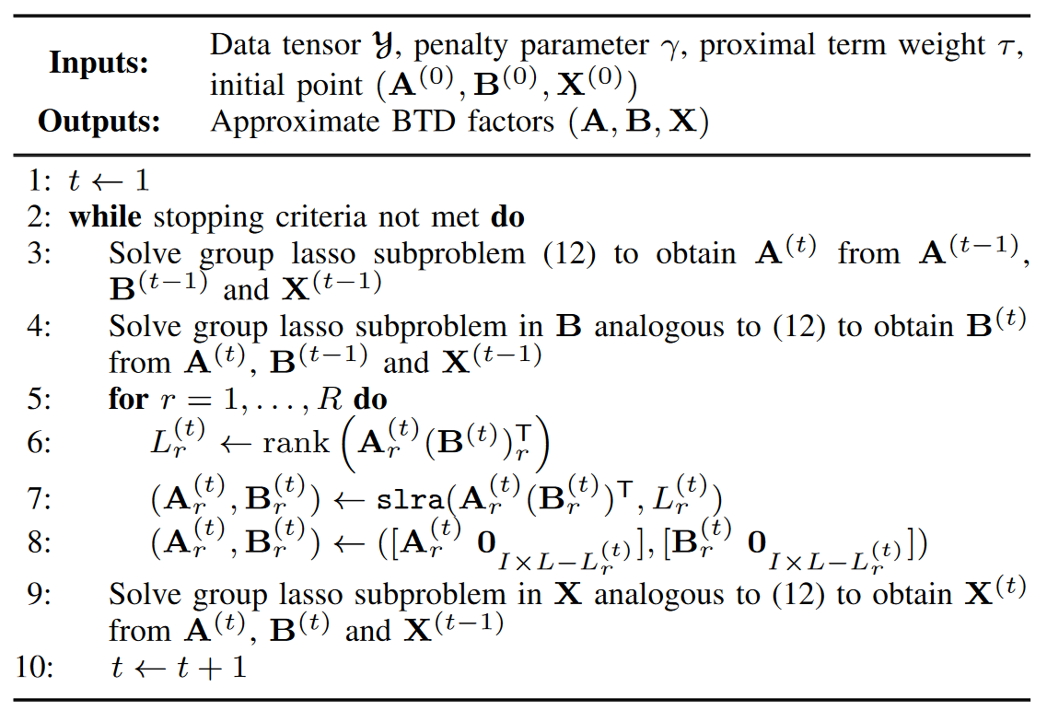
B. Algorithm for unconstrained blocks
AGL Algorithm
Solve Group Lasso Subproblems, where the factor A is estimated depending on B^{(t-1)} and X^{(t-1)}
Table I: Pseudocode for the unconstrained AGL algorithm (lines 5–8 must be omitted).

Slide 16
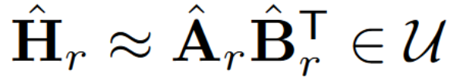
C. Handling linear constraints in Hr
CAGL Algorithm
Structured low-rank approximation (SRLA)
Table I: Pseudocode for constrained AGL algorithm.

Slide 17
IV. Numerical Evaluation on Random Block Term Decomposition Models
Notes:
A. Unconstrained BTD
B. Constrained BTD

Slide 18
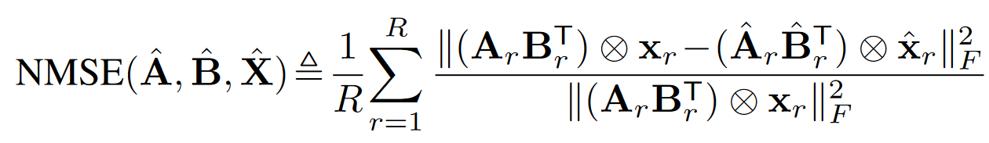
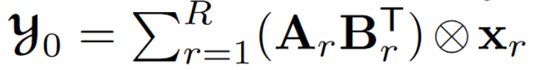
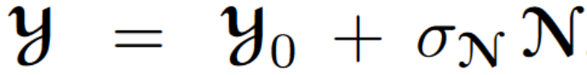
A. Unconstrained BTD
Experiment Setup
A, B, X and N in an i.i.d. fashion from the standard normal distribution.
Algebraic method with rank estimates L1 = L2 = L3 = L
AGL is run from this initial solution and using γ = γ0
Apply a γ-sweeping procedure inspired by solution-path techniques
Overestimation and true parameters
SNR of 20 dB
Notes:
Drawing the (real-valued) elements of A, B, X and N in an independent and identically distributed (i.i.d.) fashion from the standard normal distribution.
X is then normalized column-wise and the condition maxi,j |xT i xj | < 0.9 is imposed (by drawing X multiple times until it is met). To prevent nearly collinear spatial signatures.

Slide 19
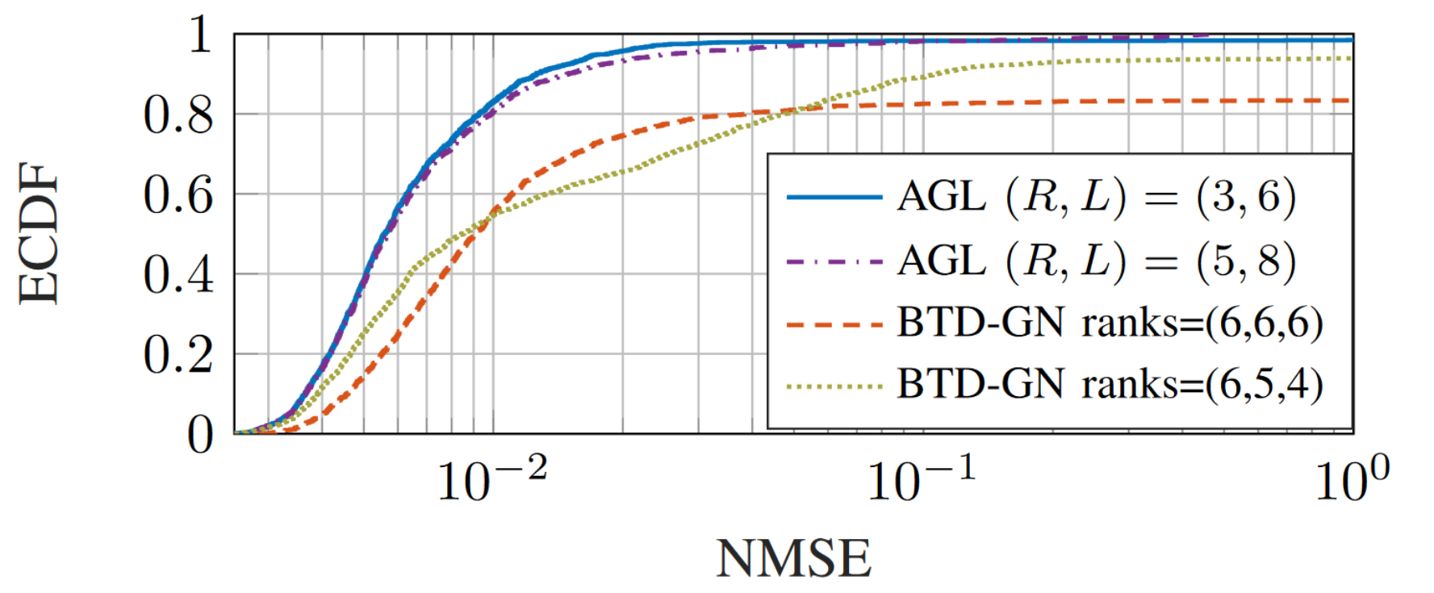
A. Unconstrained BTD
Figure 1: Empirical CDFs of NMSE over estimated blocks by AGL and BTD-GN for 500 realizations.
Notes:
NMSE attained by AGL is smaller than 0.01 for about 83% realizations with (R, L) = (3, 6)
About 80% realizations with (R, L) = (5, 8)
while the same is true for only about 58.8% realizations in the case of BTD-GN

Slide 20
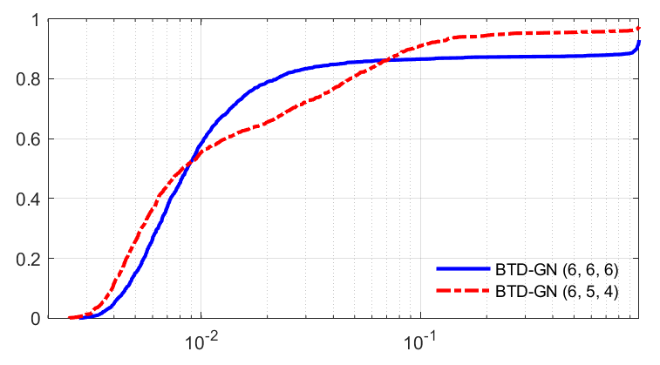
A. Unconstrained BTD
Figure: Empirical CDFs of NMSE over estimated blocks by BTD-GN for 500 realizations.

Slide 21
A. Unconstrained BTD
 | AGL (3, 6) | AGL (5, 8) | BTD-GN (6, 5, 4) | BTD-GN (6, 6, 6)
ECDF < 0.01 | 83% | 80% | 58.8% | 58.8%
True model detection | 97.6% | 87.6% | - | -
Rank Inversion | - | - | 51% | -

Slide 22
A. Unconstrained BTD
Experiment Setup
A, B, X and N in an i.i.d. fashion from the standard normal distribution.
Constrained to employ an arbitrarily initial solution (random)
AGL is run from this initial solution and using γ = γ0
Same γ-sweeping procedure
For BTD-GN and AGL, 30 and 12 initializations taken, respectively
SNR of 10 dB
Constrained Scenario
All algorithms are followed by Cadzow’s algorithm to enforce the low-rank Hankel constrain
Notes:
Projeções no Subespaço de Hankel.

Slide 23
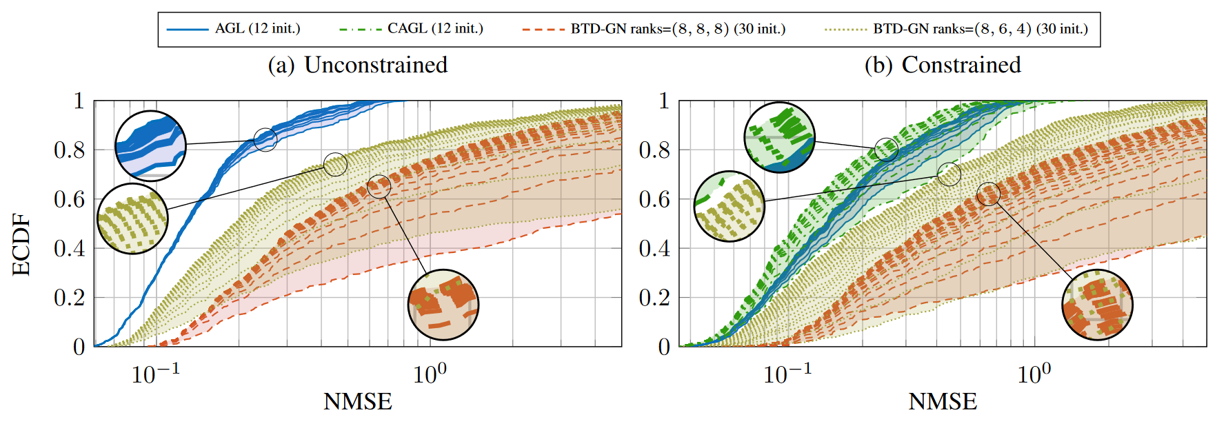
A. Unconstrained BTD
Figure 2: Empirical CDFs of NMSE over estimated blocks by AGL and BTD-GN for 500 realizations, with 12 and 30 initializations, respectively. The best solution among is chosen.
Notes:
AGL Mean time (𝝁) 4.91 s + - 1.06 s
BTD GN: 4.44 s, 4.88 s + - 3.89 s 4.04 s

Slide 24
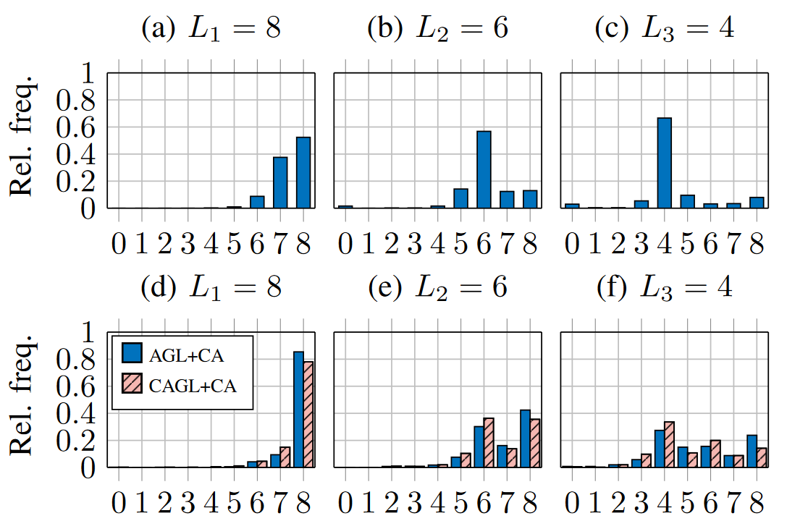
A. Unconstrained BTD
Figure 3: Proportion of block ranks estimated by AGL and CAGL with SNR = 10dB.

Slide 25
V. Experimental Results with ECG Data
Notes:
A. Tensor representation of ECG signals
B. Semi-synthetic AF data
C. Real AF data

Slide 26
A. Tensor representation of ECG signals
Experimental Setup
Each ECG lead mapped onto a Hankel matrix. Stack in the data tensor 3rd-mode.
Notes:
Tensor of dimensions 611 × 611 × 12, whose approximate BTD demands a large computing time.
To reduce it, we downsample the signals by a factor of 10 before computing the decomposition. The resulting tensor Y has dimensions 62 × 62 × 12.
Fs = 977 Hz e a região de interesse está 0 e 40 Hz, não perda de informação de interesse.

Slide 27
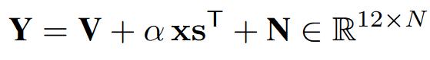
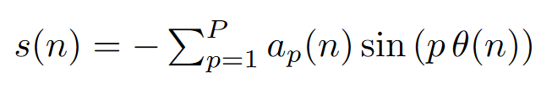
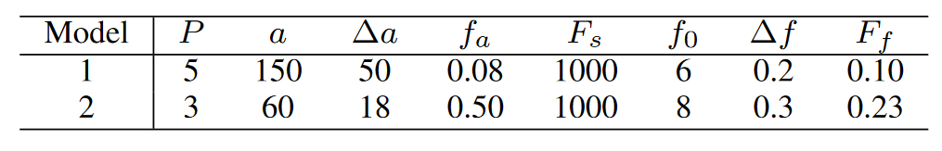
B. Semi-synthetic AF data
Sum real ventricular activity and a signal that mimics the sawtooth pattern (AF)
Random spatial signature and Additive white Gaussian noise (AWGN)
Stridh Model
Table III: Parameters of the synthetic AA signal model.
Notes:
Where a is the sawtooth amplitude, ∆a is the modulation peak amplitude, fa is the amplitude modulation frequency, Fs is the sampling frequency, f0 is the frequency value in which θ(n) varies sinusoidally, ∆f is the maximum frequency deviation and Ff is the modulation frequency.

Slide 28
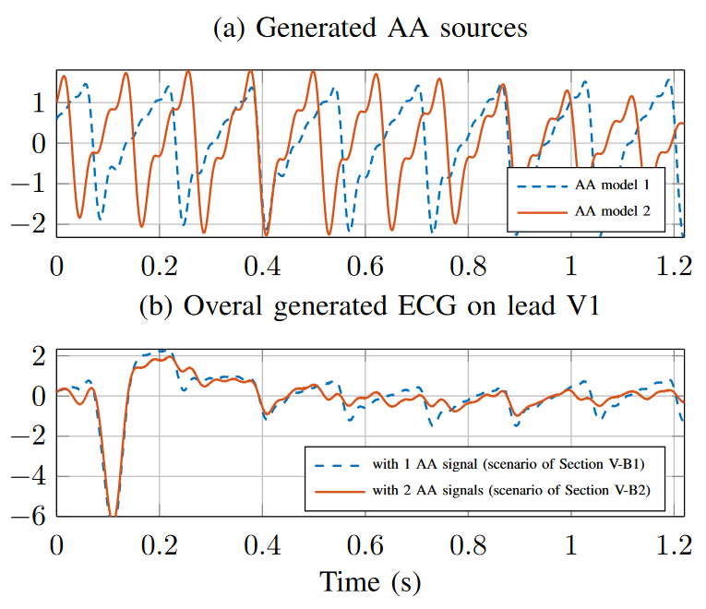
B. Semi-synthetic AF data
Figure 5: Examples of generated semi-synthetic models

Slide 29
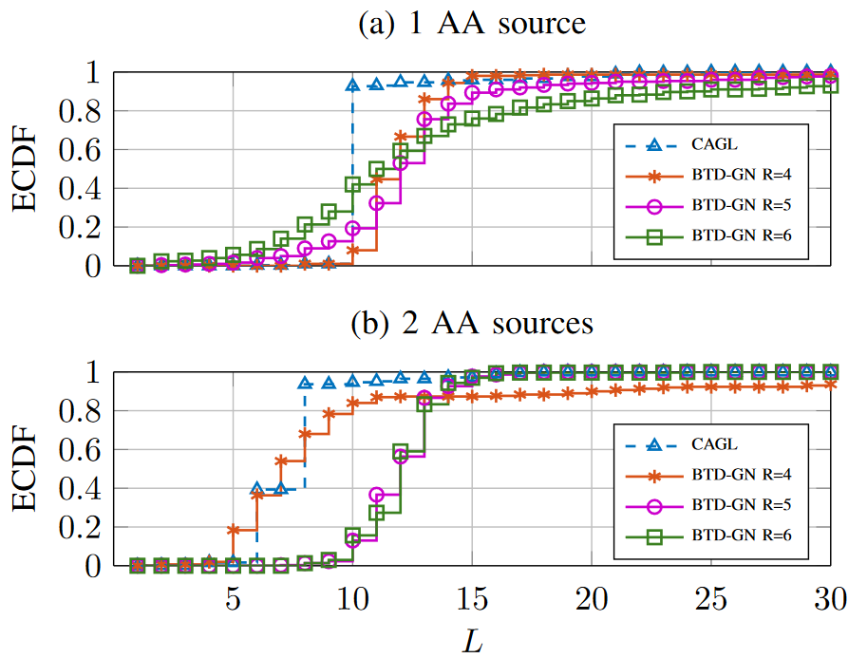
B. Semi-synthetic AF data
BTD-GN: Produces good results with a proper combination of R, L and initial point.
CAGL: Only requires choosing a reasonable range for γ, and behaves much more robustly with regard to initialization.
BTD-GN vs CAGL
Figure 6: Empirical distribution of rank chosen by CAGL for the AA source and of rank L yielding the best AA extraction for BTD-GN with different numbers of blocks R.
Notes:
1. CAGL is run with the same γ-sweeping procedure used in Section IV, but now with γ taking 30 equispaced values in the interval [8 × 10−4, 0.33 × 10−2] and keeping the last solution. For γ0, we start the algorithm from random blocks, with the initial guess of R = 6 and L = 40.
2. BTD-GN is run to estimate R blocks of fixed rank L, for all combinations (R, L) ∈ {4, 5, 6} × {1, . . . , 40}. For each rank L, the initial point is generated by filling the L columns of Ar and Br with the first L columns used to initialize these variables in CAGL
Among the estimated sources, the AA source is chosen as that which maximizes (in absolute value) the correlation coefficient ρ with respect to the ground truth s(n).

Slide 30
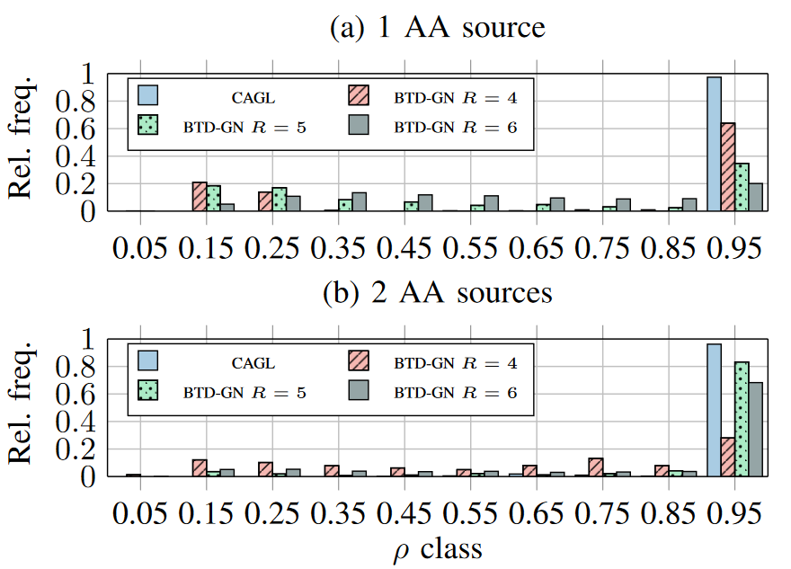
B. Semi-synthetic AF data
Figure 7: Histogram of computed correlation coefficient ρ (in absolute value) between true and estimated AA sources.

Slide 31
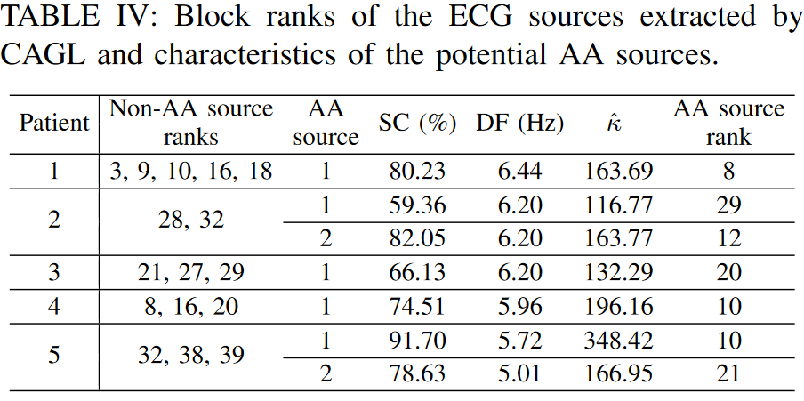
C. Real AF data
Cardiology Department of Princess Grace Hospital
Very short ECG segments: 1.08 to 1.40 seconds (Largest TQ interval)
Zero-phase forward-backward Type-II Chebyshev bandpass filter (cutoff: 0.5 and 40 Hz)
12-lead ECG recordings
Table IV: Block ranks of the ECG sources extracted by CAGL and characteristics of the potential AA sources.
Notes:
1. Dominant Frequency (3 a 9 Hz) com alta Spectral Concentration.
2. A high kurtosis is thus suggestive of a harmonic signal like AA during AF.

Slide 32
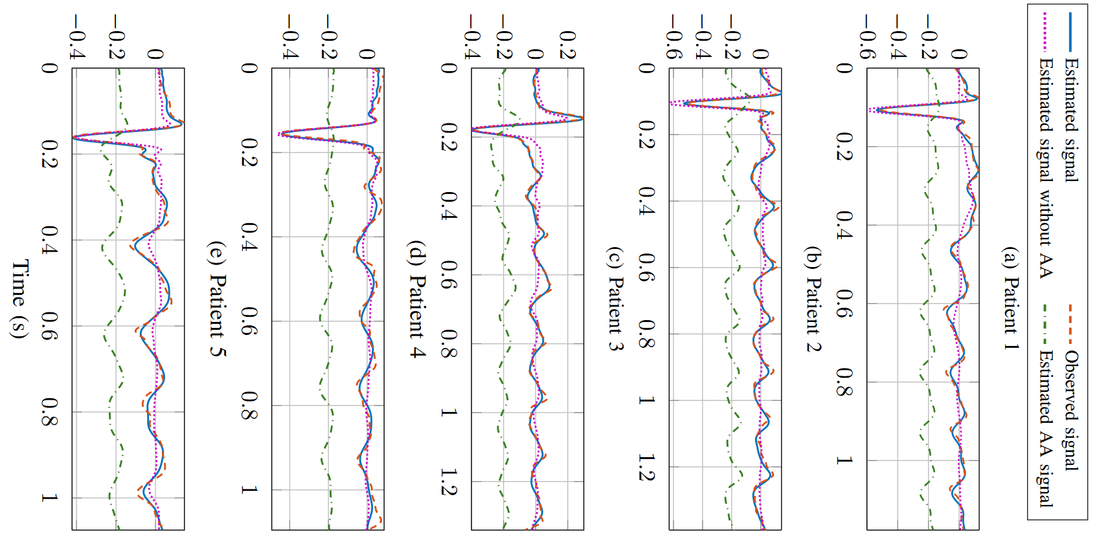
C. Real AF data
Figure 8: Results produced by CAGL with real-world ECG data: observed and estimated signals at lead V1. Estimated AA signals are vertically shifted for ease of visualization.
Notes:
Gamma sweeping procedure
It is seen that a satisfying extraction is achieved, as the potential AA sources have typical f-wave features, relatively high SC and physiologically plausible DF between 5 and 6.5 Hz

Slide 33
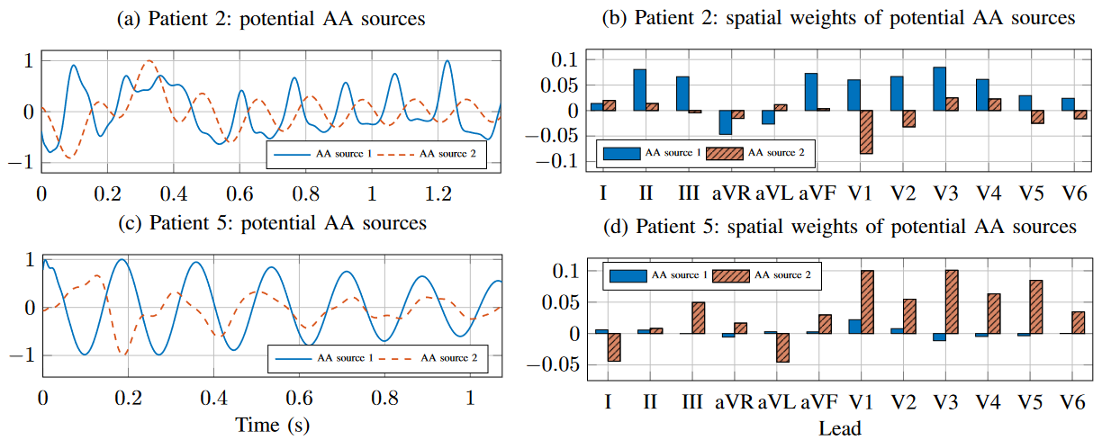
C. Real AF data
Figure 9: Results produced by CAGL with ECG data from Patients 2 and 5.
Notes:
2. While the possibility of extracting more than one atrial source presents great interest for the noninvasive analysis of AF, a thorough validation of this result would be required by means of ground truth data such as a full electroanatomical mapping of the atria performed, for instance, during catheter ablation interventions. This validation, however, is out of the scope of this paper.

Slide 34
VI. Conclusion

Slide 35
VI. Conclusion
Contributions
Allows simultaneous estimation of model parameters and factors
The resulting subproblems can be solved by existing group lasso method
Experimental results show that AGL approach and its constrained version is much more robust with respect to initialization than the conventional least-squares approach
Clinical Impact
Extract AA by using a structured low-rank approximation method
Without the need of choosing structural parameters a priori
Further Work
How to automatically tune γ in practice (CAGL)
Physiological interpretation of characteristics and spatial signatures diversity
Multiple atrial sources analysis and enlarge database of AF patients
Notes:
3.in order to provide statistically more significant results.

Slide 36
Supplementary Material

Slide 37
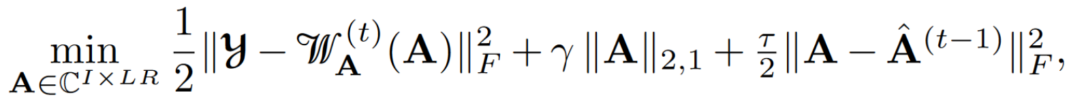
Algorithm for unconstrained blocks
AGL e CAGL
Solve Group Lasso Subproblems, where 𝔀A^{(t)}(A) is a linear map depending on B^{(t-1)} and X^{(t-1)}
Table I: Pseudocode for the unconstrained AGL algorithm (lines 5–8 must be omitted).

Slide 38
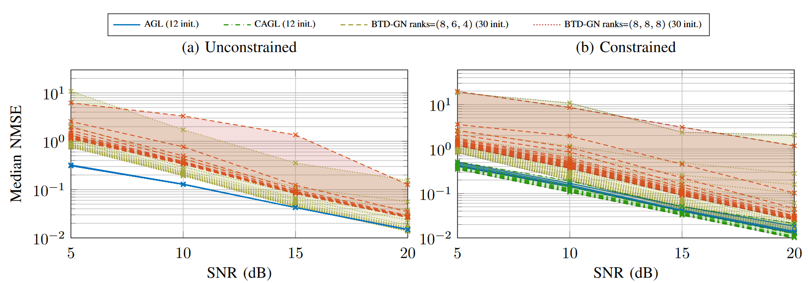
Constrained BTD: Further Results
Figure 4: Median NMSE over estimated blocks attained by AGL and BTD-GN for 500 realizations of a noisy random BTD model in the unconstrained and (Hankel-)constrained scenarios.
Notes:
The results obtained for SNR = 10 dB are depicted in
Fig. 2(b) and show that, statistically, both AGL and CAGL
Os resultados da BTD-GN se aproximam da inicial do CAGL, mas isso só observado no caso
dos postos reais são fornecidos.

Slide 39
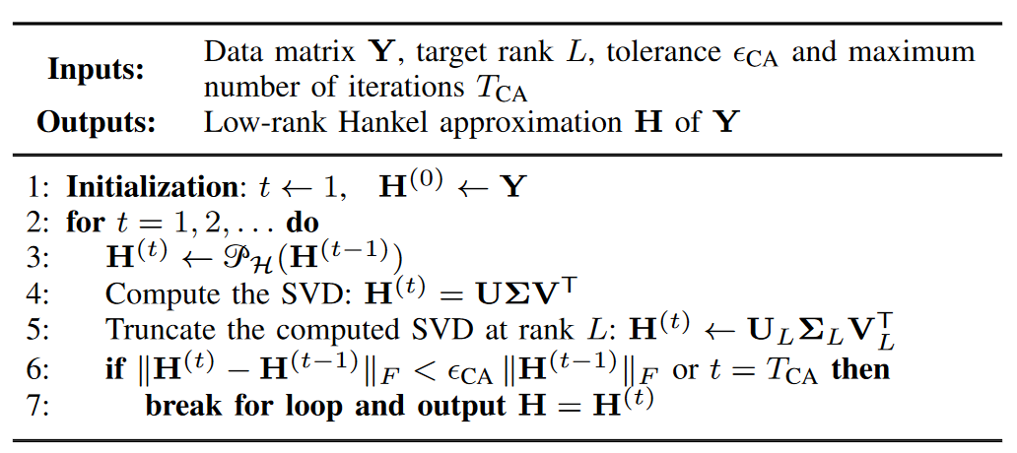
Unconstrained BTD
Cadzow’s Algorithm (CA)
Performs alternating projections onto the Hankel subspace with rank bounded by a prescribed value.
Approximations provided by CA are not (locally) optimal, but they are often satisfying in practice.
Table II: Pseudocode for the Cadzow’s algorithm.

Slide 40
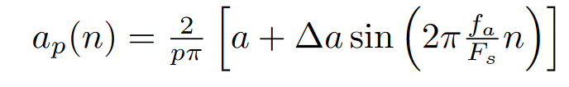
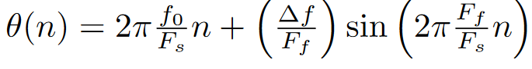
Stridh Model
Sum real ventricular activity and a signal that mimics the sawtooth pattern (AF)
Random spatial signature and Additive white Gaussian noise (AWGN)
Details
Table III: Parameters of the synthetic AA signal model.
Notes:
Where a is the sawtooth amplitude, ∆a is the modulation peak amplitude, fa is the amplitude modulation frequency, Fs is the sampling frequency, f0 is the frequency value in which θ(n) varies sinusoidally, ∆f is the maximum frequency deviation and Ff is the modulation frequency.

